Slide 1
JavaScript for beginners
TeachSurfing workshop
Workshop #3

Slide 2
Program Objectives
Workshop 1: Get to know Javascript and start working with arrays.
Workshop 2: Learn about functions. Develop the core functionality of our list application.
Workshop 3: Intro to objects, booleans, conditional statements, comparisons and loops logic.
Workshop 4: Creating a User Interface for our application (the concept of the DOM, basic HTML and CSS.

Slide 3
Agenda
Recap workshop #2 & review homework (10 min)
Block 1: Working with objects (25 min)
Block 2: Working with arrays of objects (25 min)
Break (5min)
Block 3: Working with iteration on arrays: loops (25 min)
Block 4: Working with conditional statements and comparisons (25 min)
Homework & feedback round (5 min)

Slide 4
Recap Workshop #3:
Arrays in Depth
Functions
Homework #2

Slide 5
Array methods & functions
Arrays in depth: methods:
push(),pop(),sort(),indexOf(),shift(),unshift(),splice()
Functions:
function foo() {
function body
}
foo()

Slide 6
Functions
This function returns the product of p1 and p2
function myFunction(p1, p2) {
return p1 * p2;
}
myFunction(2,3)
-> 6
2,3
2 * 3
6

Slide 7
Homework #2: demo and questions
See solution
1. Create a display function that shows only the 1st item of the list.
Alternatively, create a function that shows only the item of the chosen position.
2. Create a function to add an element at the beginning of the list array and console.log the list array.
Alternatively, create a function to add an element at a chosen position and console.log the list array.
3. Create an edit function that uses the content of the list item instead of the item index. Then console.log the array
4. Create a delete function that uses the content of the item instead of the item index.

Slide 8
BLOCK 1: Intro to objects
CONCEPT
PRACTICE
QUESTIONS?
READING SUGGESTION

Slide 9
CONCEPT: Intro to Objects in Javascript
Property name
What is an object?
var car = {
name: "Fiat",
model: 500,
start:function() {...},
stop:function() {...}
};
Property value
Object method
© Refsnes Data All Rights Reserved. https://www.w3schools.com

Slide 10
Manipulating Objects
Define car object:
var car = {
name: "Fiat",
model: 500,
displayName: function() {
return “name: “+this.name;
},
};
Read the car name value:
car.name;
Inserting a new property, i.e color:
car.color = 'blue';
using the keyword “this” to refer to a property of the same object
© Refsnes Data All Rights Reserved. https://www.w3schools.com

Slide 11
PRACTICE: Setup your Glitch project
Setup your programming environment:
Go to Glitch: https://glitch.com
Sign In and create a new Project. Call it ‘shopping-list-app’
Go to the folder public/client.js and delete all the sample content.
Now we’re ready to start building our app.

Slide 12
PRACTICE: Create shippingListApp object
Create an object and call it shoppingListApp
Add a property of type array shoppingList with three initial String items
Add a method to display the items in shoppingList
Add a method to add items to the shoppingList
Add a method to edit the shoppingList items
Add a method to delete items from the shoppingList
See proposed code

Slide 13
Questions?

Slide 14
READING SUGGESTION
You can read more on this topic in the links below:
All about objects
Javascript methods on objects

Slide 15
BLOCK 2: Working with arrays of objects
CONCEPT:
Objects to store Application data
logical operators
toggle functionality
PRACTICE:
store, edit and delete objects, toggle items.
More on this topic
QUESTIONS?

Slide 16
Objects to store Application data
We normally use objects to store data.
We can store those objects within an array:
var myArray = [{object1}, {object2}, {object3} ];

Slide 17
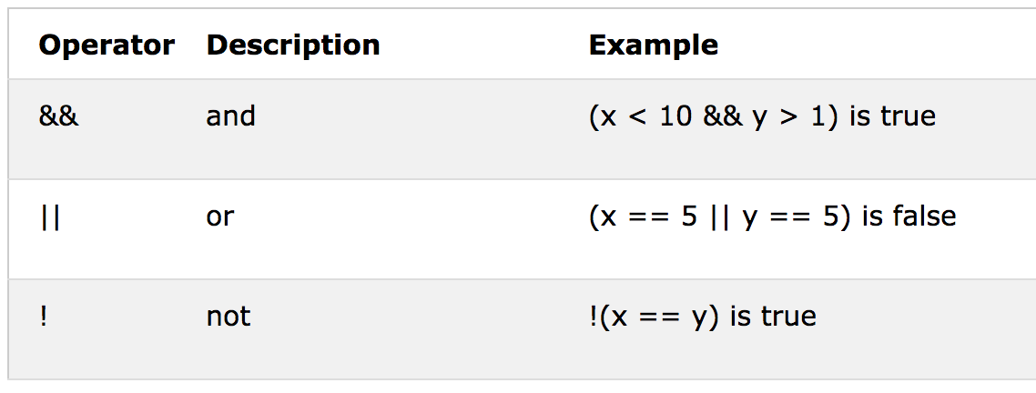
Logical operators
© Refsnes Data All Rights Reserved. https://www.w3schools.com

Slide 18
Use of logical operators and toggle functionality
Toggle functionality -> ON <-> OFF // TRUE <-> FALSE
To turn a boolean into its opposite, we use the logical operator !
var myArray = [{name: 'item1', status: false}, {name: 'item2', status: false}]
function toggle(position) {
var item = myArray[position];
item.status = !item.status;
return item.status
}

Slide 19
PRACTICE: Update shoppingList array to manage objects
STEPS:
Delete the default items that you assigned to the shoppingList array
shoppingList should now store objects with two properties:
text(string)
addedToCart (boolean)
shoppingListApp.add should add a new object
shoppingListApp.edit should change the text property of the object
See proposed code

Slide 20
PRACTICE: Add a method with logical comparison
5. Add method called toggleToCart which reverses value of the addedToCart property. For example if its value is false, it reverse it to true and vice versa.
See proposed code

Slide 21
Questions?

Slide 22
READING SUGGESTION
You can read more on this topic in the links below:
Logical operators in Javascript
Data structures with arrays and objects

Slide 23
Break
5 MINUTES

Slide 24
BLOCK 3: Iterating over arrays (for loop)
CONCEPT
PRACTICE
QUESTIONS?
READING SUGGESTION

Slide 25
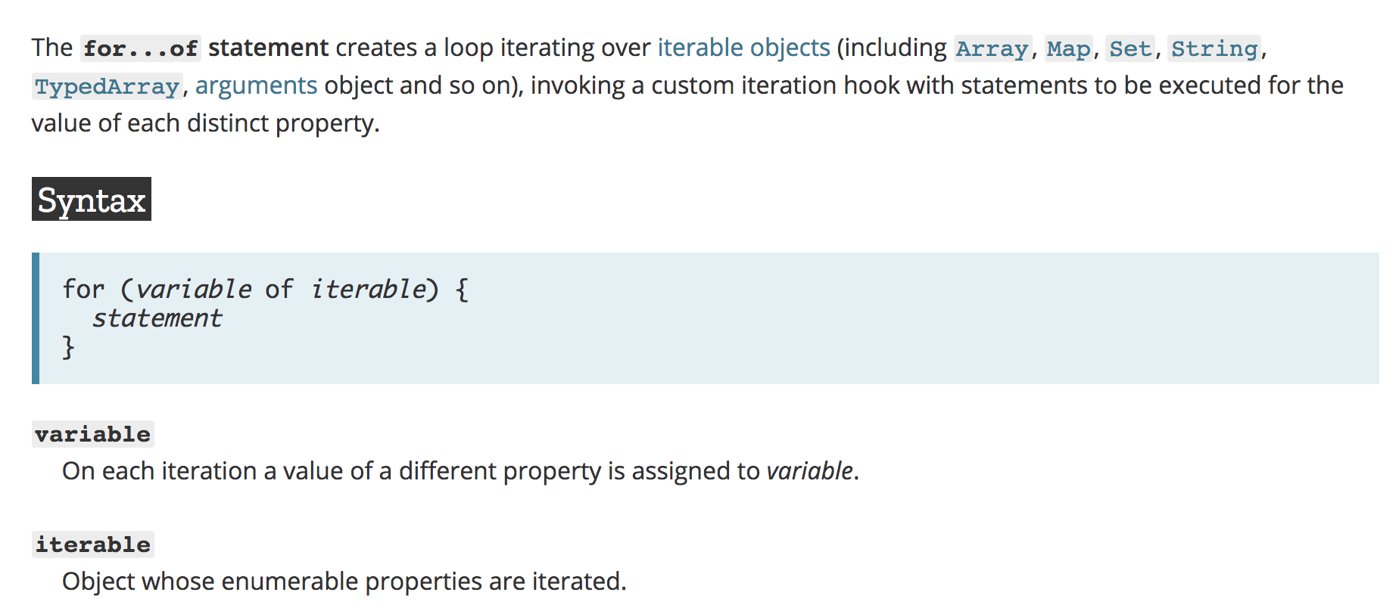
for…of loop (see more documentation)
© Mozilla. Licensed under the Creative Commons Attribution-ShareAlike 2.5 Generic License.

Slide 26
For… of (example) Try on your console
Pseudocode:
for(variable representing each array item of an array) {
what you want to repeat
}
Code:
var names = ['Nadine', 'Bob', 'Sandra'];
for(var item of names) {
return 'Hey ' + item + ' !';
}

Slide 27
PRACTICE: Iterating over arrays with for... of loop
Rewrite the display method of the shoppingListApp to display only the text property of the objects
Hint: Use for… of loop to iterate over all the objects in shoppingList and to print text property of each object.
See proposed code

Slide 28
Questions?

Slide 29
READING SUGGESTION
You can read more on this topic in the links below:
Other for loops to check
Iterating with array methods rather than loops:
See forEach(), map() and filter() methods
Advanced: recursion as means of iteration

Slide 30
BLOCK 4: Working with conditional statements and comparisons
CONCEPTS
PRACTICE
QUESTIONS?
READING SUGGESTION

Slide 31
Intro to If… else conditionals
Code:
var rains = true;
if(rains) {
console.log("take the umbrella");
}
else {
console.log("don't take the umbrella");
}
And with "rains = false" ?
Pseudocode:
if it rains: take the umbrella
else: don't take it

Slide 32
PRACTICE: If … else
1- Copy this conditional statement in the console
2- Set rain property to false and run the code again
Code:
var rains = true;
if(rains) {
console.log("take the umbrella");
}
else {
console.log("don't take the umbrella");
}

Slide 33
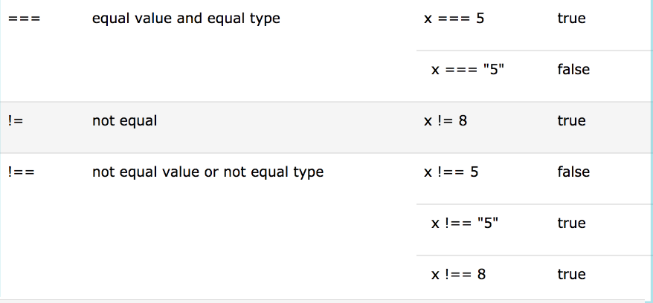
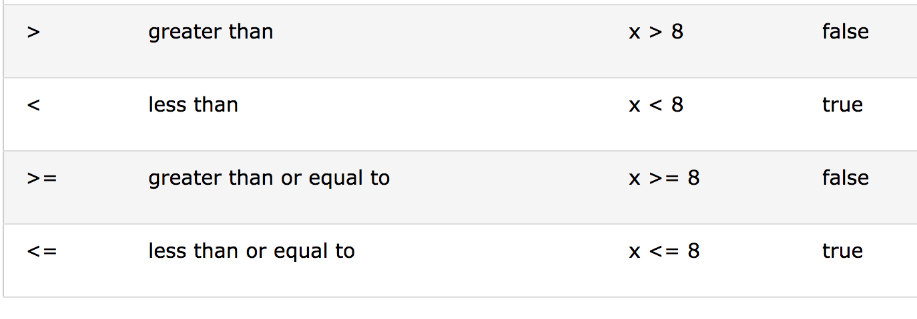
Comparison Operators
© Refsnes Data All Rights Reserved. https://www.w3schools.com

Slide 34
Questions?

Slide 35
READING SUGGESTION
You can read more on this topic in the links below:
Have a look at the else if conditional statement and switch
For cleaner conditional syntax, see ternary operators

Slide 36
Homework #3
1- Create a new method toggleAll, which checks the addedToCart value of all the items. If all the addedToCart values are true:
Then set them all to false.
Otherwise switch addedToCart to true for all items
2- Further readings:
Javascript operators
Increment a number with javascript
See solution

Slide 37
Questions and
feedback round

Slide 38
© TeachSurfing gUG, 2018
© 2018 by TeachSurfing gUG, Marta Farre, Alejandro G. Martinez. Unless otherwise noted, this work is licensed with a Creative Commons Attribution-NonCommercial 4.0 International License. To view a copy of this license, visit http://creativecommons.org/licenses/by-nc/4.0/.
Attributions:
Slides 9, 10, 17: © Refsnes Data All Rights Reserved. https://www.w3schools.com
Slide 25: © Mozilla Creative Commons Attribution-ShareAlike 2.5 Generic License.
Slide 33: © Watch and Code All Rights Reserved. https://watchandcode.com

