Slide 1
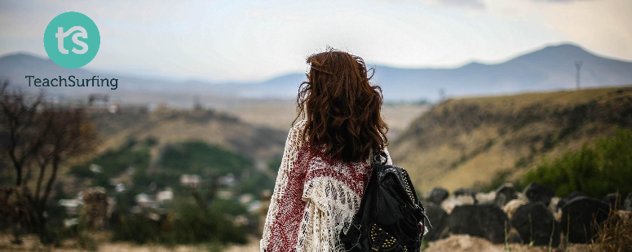
TeachSurfing.org
Author:
Khaled Khudr
Arabic Language Trainer / Supervisor
Khaled@teachsurfing.org
Everyone knows something
valuable for someone else
Notes:
Please make sure to introduce and explain the idea behind TeachSurfing.

Slide 2
Introduction into
Arabic language
Notes:
Here, you can introduce yourself and your story with TeachSurfing.

Slide 3
Agenda
Section 1:Introduction about TeachSurfing, yourself and the first contact with audience (10 min)
Section 2:Introduction to the Arabic language (history, myths, logic) (15 min)
Section 3:Introduction to the alphabet and the theory of arms (20 min)
Section 4:Introduction to starter words and singing a song (20 min)
Section 5:Practice with volunteers in small groups (25 min)

Slide 4
Section 1: Introduction
القسم الأول

Slide 5
enables people to share their knowledge voluntarily with schools and communities worldwide
TeachSurfing
Notes:
Here you can use this questions :
Whom am I ?
Why you came today? (for the participants)
What is you expectations?

Slide 6
Section 2: Introduction to the Arabic language (history, myths, logic)
القسم الثاني

Slide 7
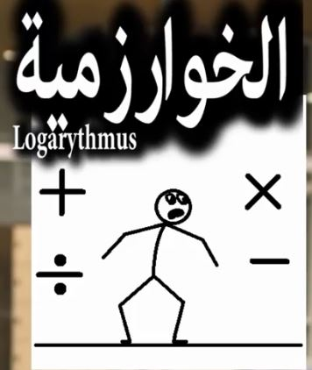
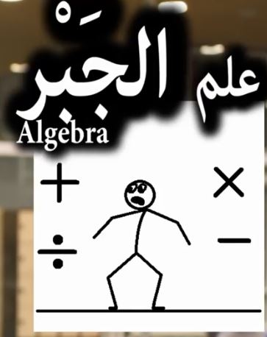
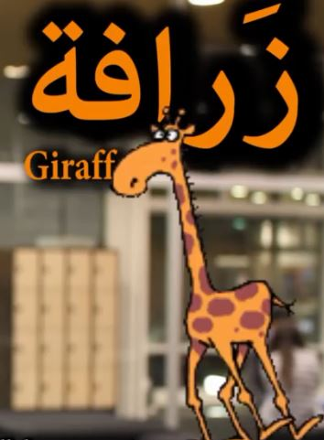
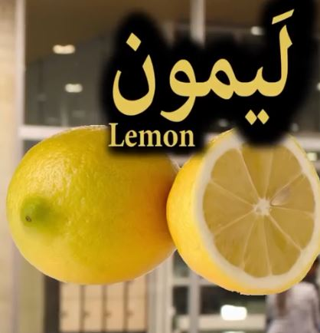
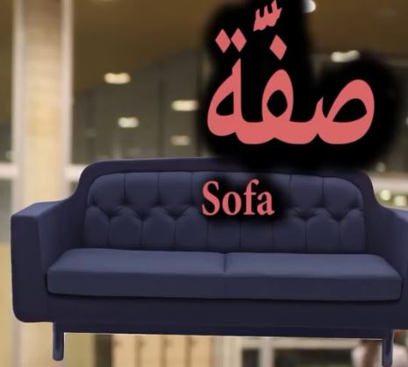
الكيمياء
Notes:
Please begin with explaining the Arabic origin of some of the words in English and German. To make the workshop more fun I also tell below story with the pictures from this slide:
The first thing I did today after coming back from university is relaxing on the SOFA and drinking EINE TASSE KAFFE MIT ZUCKER which is on of my favorite drinks besides MUKKA LEMMONADE AND ORANGE . After that I made my lunch which was RICE with SPINAT and ARTICHCKES. During the meal I was thinking about my planned SAFARI trip that I will do on vacation. The trip will be in Africa for sure I will see GIRAFFES there. Later I talked with my friend Max ,he told me that he will go to a party so I told him not to drink ALKOHOL because tomorrow we have an exam in ALGEBRA and LOGARITHM then a CHEMISTRY experiment in the lab .
Do you know that LILA, ZIFFER, ZAFFARON, TARIF, and even more words come from Arabic???
Note: I was targeting people, who live in Germany so I chose German words but you can use any other language depending on your target group.

Slide 8
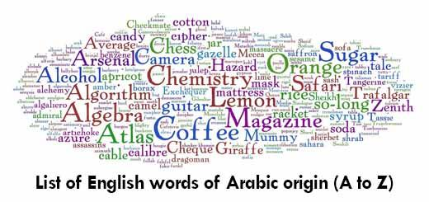
Notes:
There are many English words with Arabic origin. Just like in this example.

Slide 9
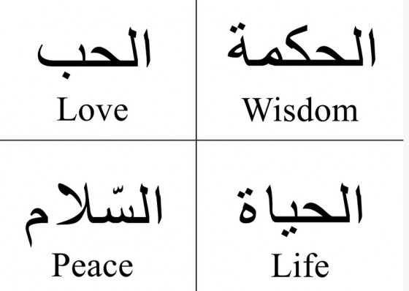
“The beauty of man lies in the eloquence of his tongue” (Arabic saying)
Notes:
Here, try to talk about how important these words are in Arabic culture.

Slide 10
Notes:
The next step is to follow the videos. Source : https://youtu.be/flcVUaIbNEU

Slide 11
Syria through my eyes…
Notes:
Source : https://youtu.be/flcVUaIbNEU

Slide 12
Syria through my eyes…
Notes:
Source : https://youtu.be/flcVUaIbNEU

Slide 13
Syria through my eyes…
Notes:
During this video, remind your students that they can find examples of common Arabic letters in many of the world's other major languages, for example:
French: غ is like the French R
German:خ is like ch in German in the word acht
Italian: ر is like the Italian R sometimes like the English one
English: most of the rest of the letters
In addition, they don’t need to pronounce ط ظ ض ص ع ح and the other difficult letters as long as they are beginners. They can use the other easier letters instead. For example the first letters in words like Tark, Adel or Habibi. Source : https://youtu.be/flcVUaIbNEU

Slide 14
Notes:
After the previous slide, you can show to your students how the Arabic script looks like.

Slide 15
Syria through my eyes…
Notes:
Again, follow the videos. Source : https://youtu.be/flcVUaIbNEU

Slide 16
Syria through my eyes…
Notes:
Source : https://youtu.be/flcVUaIbNEU

Slide 17
Syria through my eyes…
Notes:
Source : https://youtu.be/flcVUaIbNEU

Slide 18
Section 3: Introduction to the alphabet and the theory of arms
القسم الثالث

Slide 19
The Alphabet
Notes:
This is the second part of the workshop. It is time to learn about the alphabet. Make sure the your students have a copy of the alphabet and short intro worksheet.

Slide 20
The theory of arms
Notes:
Here, I use a simplified method to explain the different forms of letters ( contextual form (final, medial, initial) and isolated form). I call this method “the theory of arms”.
To make it easier, imagine that each letter has two arms. In the different forms, they may or may not use their arms.
in the isolated form, the letters do not use their arms
In the initial form, the letters use only the left arm
In the medial form, the letters use both arms
In the final form, the letters use only the right arm
Please remember there are exceptions to this rule. The six letters who lost their left arms دذوزر
Practise 1: write together with your students the Latin version of the Arabic letters.
Practise 2: puzzle game.
Tell the students to see this table as puzzle pieces. For example, you can use the name Khaled (in Arabic) and show them how to write it by using this table (connecting the letters and their corrects forms like puzzles). For each letter they should follow these steps:
Step one: find the right letter
Step two: find the right form of this letter depending of its position
Step three: choose the next letter in the word and go to step one and so on.
Finally, the students are ready to write the word Khaled. The volunteers can also help here.

Slide 21
Notes:
Source : https://youtu.be/QSLtNmRflBU

Slide 22
Arabic calligraphy
Notes:
Now, it is time to show some examples of Arabic calligraphy.

Slide 23
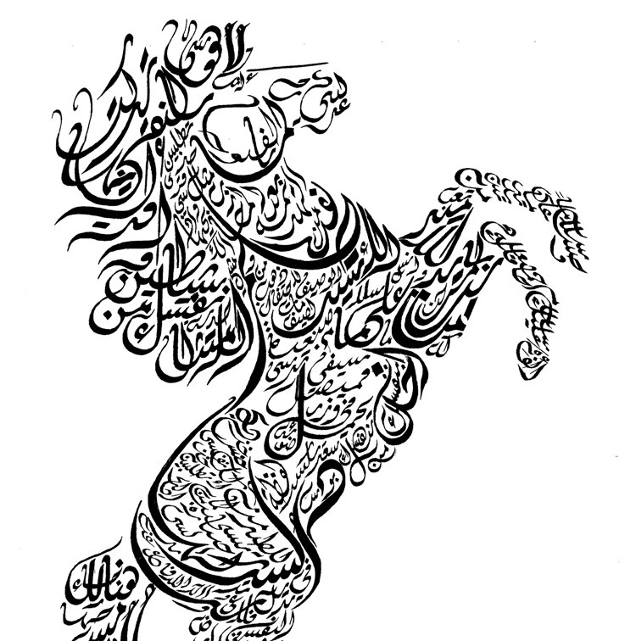
Arabic calligraphy
Notes:
Here, you can tell your students about hidden messages in these pictures.

Slide 24
Section 4: Introduction to starter words and singing a song
القسم الرابع

Slide 25
Greetings
Notes:
Now, it is time to learn greetings in Arabic.

Slide 26
Notes:
Here, follow the video on how to introduce yourself. Source : https://youtu.be/ityVW2gR0Rs

Slide 27
Notes:
Follow the video on further greetings. Source : https://youtu.be/ityVW2gR0Rs

Slide 28
Greetings
Notes:
Make sure that all your students have a copy of this material. Now, you can practice together basic greetings in Arabic.

Slide 29
Let’s sing a song
MARHABAN AHLAN WA SAHLAN
MARAHABAN YA ASDIKAA
MAL AKHBARU KAYFAL HALU
MARAHABAN YA ASDIKAA
MAL AKHBARU KAYFAL HALU
MARAHABAN YA ASDIKAA
Notes:
Before you go on with the song, make sure to tell your students the meaning of the new words used in the song. Next, sign the song for them.

Slide 30
Let’s sing a song
MARHABAN AHLAN WA SAHLAN
MARAHABAN YA ASDIKAA
MAL AKHBARU KAYFAL HALU
MARAHABAN YA ASDIKAA
MAL AKHBARU KAYFAL HALU
MARAHABAN YA ASDIKAA
Notes:
Here, it is time to sing this song all together.

Slide 31
Let’s sing a song
MARHABAN AHLAN WA SAHLAN
MARAHABAN YA ASDIKAA
MAL AKHBARU KAYFAL HALU
MARAHABAN YA ASDIKAA
MAL AKHBARU KAYFAL HALU
MARAHABAN YA ASDIKAA
Notes:
Now, make the students sing it alone.

Slide 32
Let’s sing a song
MARHABAN AHLAN WA SAHLAN
MARAHABAN YA ASDIKAA
MAL AKHBARU KAYFAL HALU
MARAHABAN YA ASDIKAA
MAL AKHBARU KAYFAL HALU
MARAHABAN YA ASDIKAA
Notes:
Finally, it is time to sing it all together. One more time!

Slide 33
Section 5: Practice with volunteers in small groups
القسم الخامس

Slide 34
Hayya bina .. Let’s practice
Notes:
Here, it is time to practise more with Arabic speaking volunteers (if possible). The best way is to have one volunteer for 3-4 students. They should practice what they have learnt. Have fun!

